Slide 1

Symmetries and conservation laws in particle physics:

Slide 2
Conservation laws in particle physics can be divided into two categories.
    Universal conservation laws: Holds for all four fundamental interactions.
    Particular conservation laws: Does not hold in all four fundamental interactions.
Conservation laws:
Universal:
Energy(E).
Linear momentum(p).
Angular momentum(J).
Lepton number(L).
Baryon number(B).
Charge(Q).
CPT.
Particular:
Isospin(I).
Strangeness(S).
Hypercharge(Y).
Parity(P).
Charge conjugation(C).
Time reversal(T).
CP

Slide 3
In the previous classes, we have already discussed conservation laws of energy, Electric charge and linear momentum.
Conservation of angular momentum:
  Conservation of angular momentum is due to rotational symmetry and is verified by checking conservation of spin angular momentum.
  Consider the reaction, n ------→ p + e⁻ (1)
  All are fermions here so, spin is not conserved. This is not a valid reaction.
  But n---→ p + e⁻ + ϑ_{e} (2) where, ϑ_{e} represents, electron anti-neutrino.
  Now the spin is conserved and hence we say that angular momentum is conserved.

Slide 4
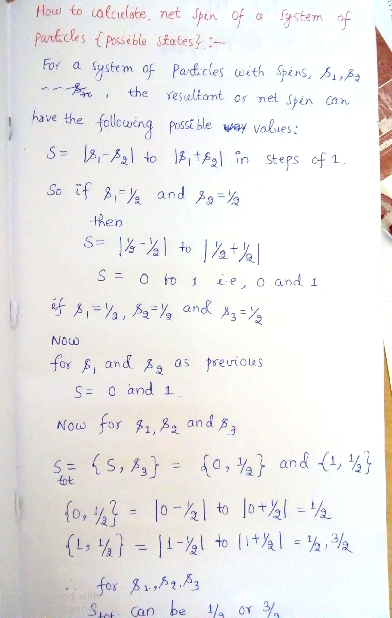

Slide 5
Lepton number and its Conservation :
Lepton number is a charge assigned as below:
+1 for all leptons, -1 for all anti-leptons and 0 for non leptons.
  “This law states that, in any particle reaction or decay the total number of leptons is always conserved.”
Illustrations:
Consider the following reactions:
  n -----→ p + e⁻ (not allowed.)
  n -----→ p + e⁻ + ϑ_{e} (allowed)
  n -----→ p + e⁻ + ϑ_{e} (not allowed)
  μ⁺ ----→ e⁺ + ϑ_{e} + ϑ_{e} (allowed)
  λ⁰ -----→ p +π⁻ (allowed)

Slide 6
Baryon number and its Conservation :
  Baryon number is also a charge and assigned as below:
  +1 for baryons, -1 for anti baryons and all other particles like mesons, leptons and quanta of force carry baryon number equal to zero.
  “This law states that, in any particle reaction or decay the total number of baryons is always conserved.”
    Illustrations:
    Consider the following reactions:
    λ⁰ -----→ p +π⁻ (allowed)
    λ⁰ -----→ p +π⁺ ( not allowed)
    π⁺ + n----→ K⁰ +K⁺ (not allowed)

Slide 7
Isospin and its conservation:
Iso means same and hence isospin literally means “similar to spin”.
Neutrons and protons have many similar properties like spin, mass but not charge.
But nuclear force is charge independent and electromagnetic force will not affect much on strong interaction between protons and neutrons.(1/137 times weaker than strong interaction.)
Therefore in the world of strong interaction, we can think of protons and neutrons as two orthogonal states { different states} of same particle called “nucleon”.
Calculation of I and I₃ for different family of particles:
Multiplicity , M=2I+1, where I represents isospin.
Nucleon family(proton and neutron) : here M=2; 2I+1=2 therefore; I=1/2.
The third component of isospin, I₃ (represents different orthogonal states or degenerate states in strong interaction) can have the values –I to +I in steps of one.
Therefore, possible values of I₃ for nucleon family is I₃ =+1/2 for proton and I₃ =-1/2 for neutron.
Respective anti particles will have isospin values reversed in sign.

Slide 8
Family, members and multiplicity | I | I₃
Nucleon family: n⁰ and p⁺ ;M=2. | 1/2 | +1/2 for p⁺ and -1/2 for n⁰
Pion family: π⁺, π⁻ and π⁰ ; M=3. | 1 | -1 for π⁻, 0 for π⁰ and +1 for π⁺ .
K- family: K⁺ and K⁰ ; M=2 | 1/2 | +1/2 for K⁺ and -1/2 for K⁰
∑ family: ∑⁺ , ∑⁻ and ∑⁰ ; M=3. | 1 | +1 for ∑⁺,0 for ∑⁰ and -1 for ∑⁻ .
Δ family: Δ⁺⁺ , Δ⁺ , Δ⁻ and Δ⁰; M=4 | 3/2 | +3/2 for Δ⁺⁺ , +1/2 for Δ⁺ , -1/2 for Δ⁰ and -3/2 for Δ⁻
Ξ family: Ξ⁻ and Ξ⁰ ; M = 2 | 1/2 | +1/2 for Ξ⁰ and -1/2 for Ξ⁻
Ω family: Ω⁻ ; M=1 | 0 | 0
Λ family: Λ⁰ ; M=1 | 0 | 0

Slide 9
Conservation of isospin:
Isospin I is conserved in strong interactions only; not in weak or electromagnetic interactions.
The third component of isospin I₃ is conserved in strong and electromagnetic interactions but not in weak interactions.
Illustrations:
Consider the following reactions:
  P + P -----→ Λ⁰ + K⁰ + P + π⁺ (allowed)
  Δ⁺ --------→ P + π⁰ (allowed)
  Λ⁰ ---------→ P + π⁻ (not allowed)
  ∑⁰ ----------→ Λ⁰ + ϒ (not allowed)

Slide 10
Strangeness and Hypercharge:
(Gell-Mann– Nishijima scheme)
Strangeness:
We know that baryons are divided into :
  Nucleons: protons and neutrons.
  Hyperons: The term hyperons refers to those unstable particles which carry additional quantum number called “strangeness” to distinguish them from nucleons. The well known hyperons are :
    Λ hyperons.
    ∑ hyperons.
    Ξ hyperons and
    Ω hyperons.
These hyperons are observed to behave in a strange manner as given below:
  They are produced by strong interaction ( characteristic time of 10⁻²³ s) and decay through weak interactions (characteristic time of 10⁻⁸ s).
  They are always produced in pairs: with following one exception:
  ∑⁰ ----------→ Λ⁰ + ϒ (EM interaction)

Slide 11
Example:
  P + π⁻ ------→ Λ⁰ + K⁰ (strong interaction; 10⁻²³ s)
  Where Λ⁰ and K⁰ decays by weak interaction(10⁻⁸ s) as:
  Λ⁰ -----→ n + π⁰
  K⁰ ------→ π⁺ + π⁻
  Calculation of strangeness value for hyperons:
  Strangeness of any hyperon can be calculated from Gell-Mann– Nishijima formula which is given by :
  Q = I₃ + Y/2 -------→(1)
  Where Q is electric charge, I₃ is third component of isospin and Y is hypercharge.
  and Y = B + S where again, B is baryonic number and S is strangeness.
  Therefore, equation (1) becomes ;
  Q = I₃ + (B + S)/2 -----→(2)
  From which, the equation for strangeness S becomes;
  S = 2(Q – I₃) – B ------→ (3)

Slide 12
Strangeness of some notable hyperons:
Hyperon | Q | B | I | I₃ | S
K⁺ | +1 | 0 | 1/2 | +1/2 | +1
K⁰ | 0 | 0 | 1/2 | -1/2 | +1
∑⁺ | +1 | +1 | 1 | +1 | -1
∑⁻ | -1 | +1 | 1 | -1 | -1
∑⁰ | 0 | +1 | 1 | 0 | -1
Ξ⁻ | -1 | +1 | 1/2 | -1/2 | -2
Ξ⁰ | 0 | +1 | 1/2 | +1/2 | -2
Λ⁰ | 0 | +1 | 0 | 0 | -1
Ω⁻ | -1 | +1 | 0 | 0 | -3
Strangeness number is zero for all other particles like nucleons, mesons and leptons.

Slide 13
Conservation of strangeness:
“ Total number of strange particles in a reaction or decay is conserved”.
One more strangeness about strangeness conservation law is, it holds in strong interaction(i.e., during production) and violated in weak interaction(i.e., during decay).
Illustrations:
P + π⁻ --------→ Λ⁰ + K⁰ (allowed)
P + π⁻ ---------→ n + K⁰ (not allowed)
P + π⁻ --------→ ∑⁰ + K⁰ (allowed)
n + π⁻ --------→ ∑⁻ + K⁰ (allowed)

Slide 14
Hypercharge and its conservation:
Hypercharge (Y) is given by :
Y = B + S
Hypercharge is conserved in strong interactions and EM interactions only.
Calculation of hypercharge for different family of particles:
Family | B | S | Y = B + S
Nucleons | +1 | 0 | +1
Sigma[∑ ] | +1 | -1 | 0
Cascade[Ξ] | +1 | -2 | -1
Kaons [K] | 0 | 1 | 1
Lambda[Λ] | +1 | -1 | 0
Omega[Ω] | +1 | -3 | -2

Slide 15
Illustrations:
P + π⁻ --------→ Λ⁰ + K⁰ (Allowed)
P + π⁻ ---------→ n + K⁰ (not allowed)
π⁺ + n----→ K⁰ +K⁺ (not allowed)
λ⁰ -----→ p +π⁻ ( Not allowed)

